Slide 1


Introduction to Operating Systems CS 1550
Spring 2023
Sherif Khattab
ksm73@pitt.edu
(Some slides are from Silberschatz, Galvin and Gagne ©2013)

Slide 2
Announcements
Upcoming deadlines
Homework 10 due this Friday
Project 3 is due this Friday at 11:59 pm
Lab 4 is due on Tuesday 4/11 at 11:59 pm

Slide 3
Previous lecture …
Problem of Too Large Page Tables
multi-level page tables + TLB
inverted page tables

Slide 4
This lecture …
Miscellaneous Memory Management Issues
How to allocate disk blocks to files and directories?
contiguous, linked, FAT, indexed, and hybrid

Slide 5
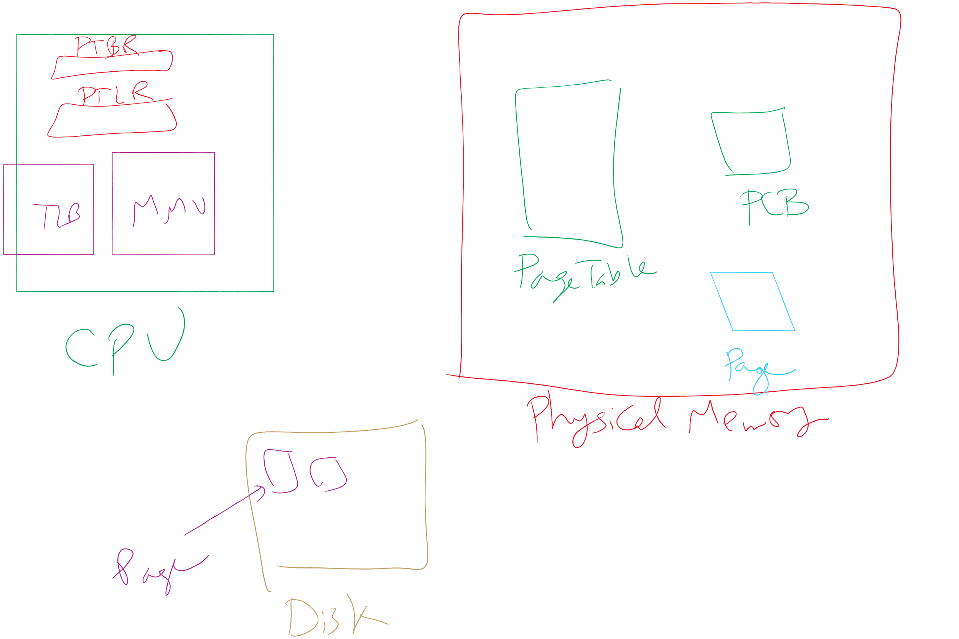
MMU, TLB, Page Tables, etc.

Slide 6
How big should a page be?
Smaller pages have advantages
Better fit for various data structures, code sections
Less unused physical memory (some pages have few useful bytes and the rest isn’t needed currently)
Less internal fragmentation
Faster disk write and read
Larger pages also have advantages
Less overhead (smaller page tables)
Lower TLB miss rate
TLB covers more memory with same number of entries
Faster page replacement algorithms (fewer entries to look through)
Higher throughput of disk transfers

Slide 7
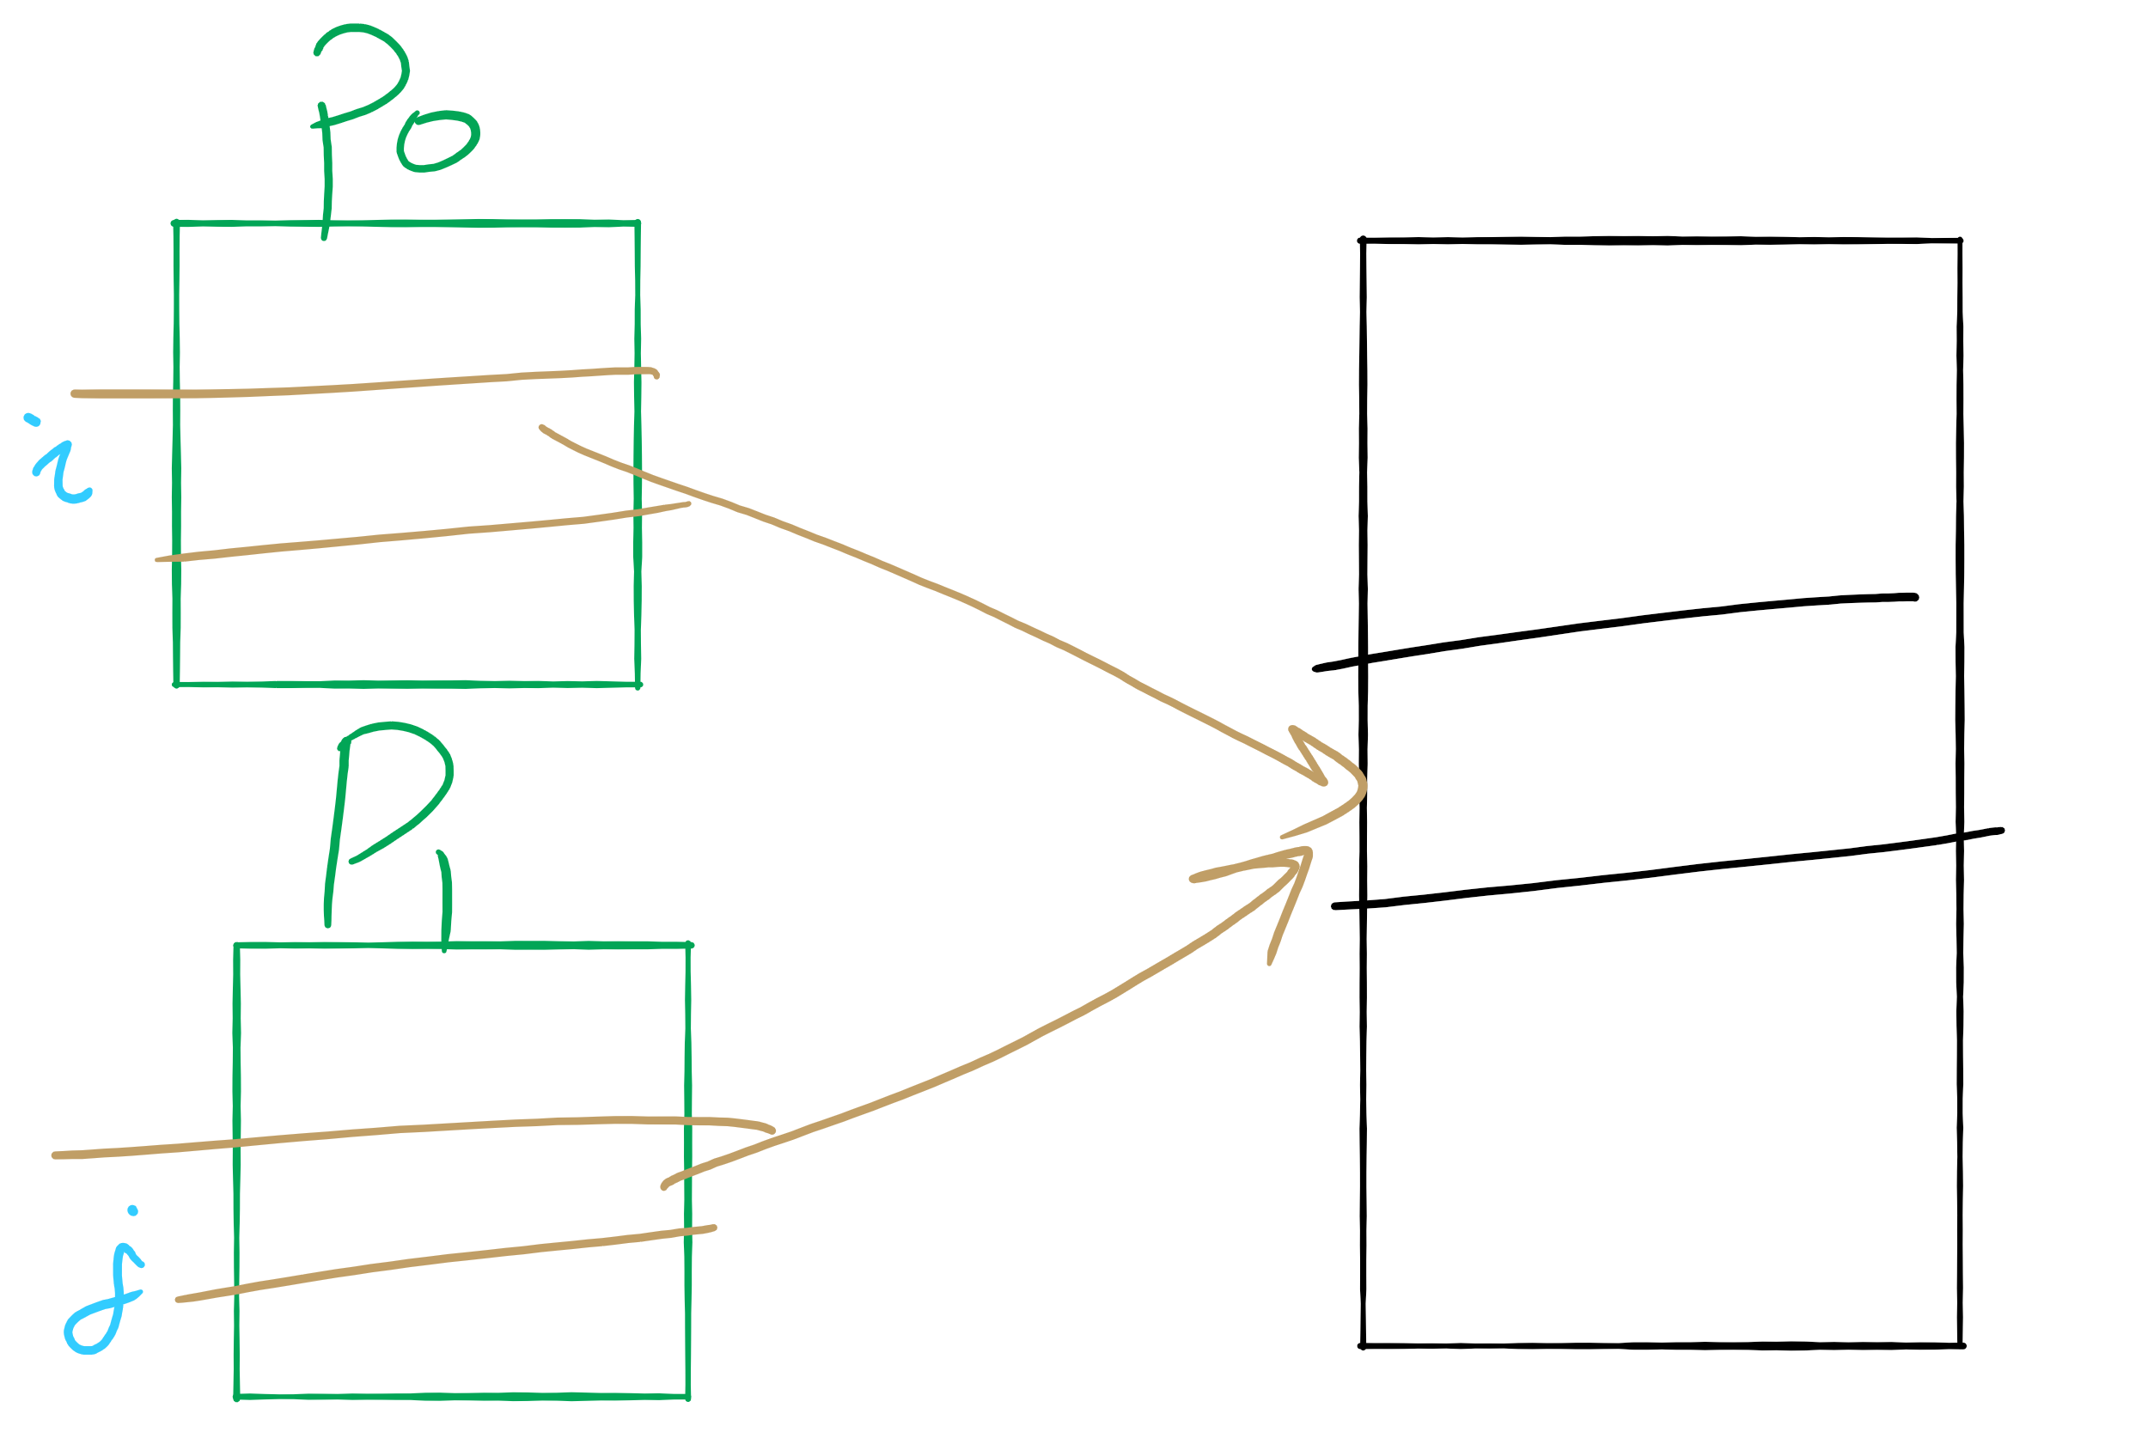
Sharing Pages Between Processes
Page Table for Process P0
Shared Page
Page Table for Process P1
Physical Memory

Slide 8
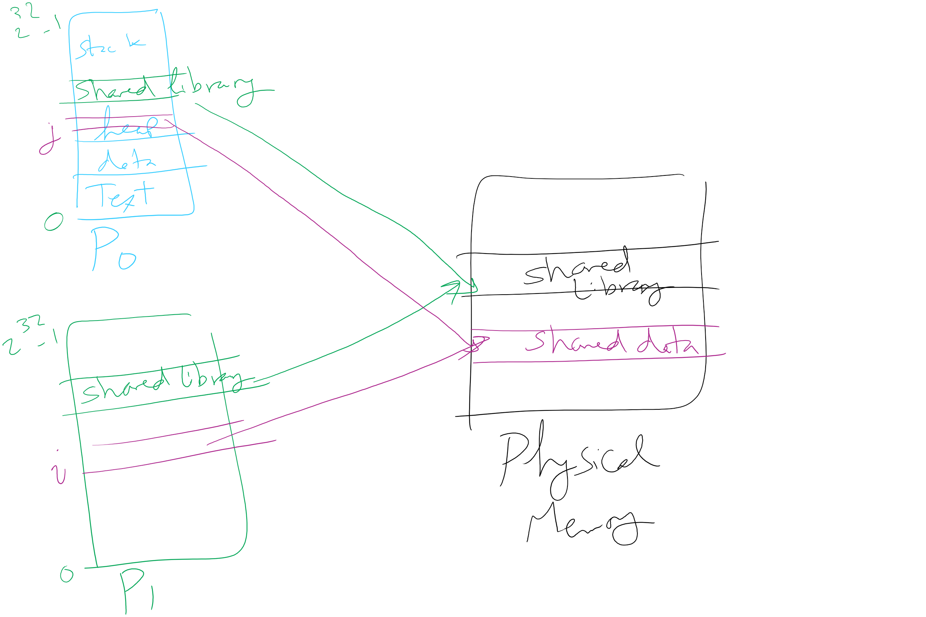
Page Sharing: Why?
Code sharing (e.g., C standard library)
Data sharing (need for process synchronization)

Slide 9
Sharing pages: How?
Processes share pages
Entries in page tables point to the same physical frame
Easier to share code: no problems with modification
Virtual addresses for shared pages (i == j?)
Same: easier to exchange pointers, keep data structures consistent
difficult if many processes share with each other
Different: easier to actually implement
Page Tables
Shared Page
Physical Memory

Slide 10
When does OS manage memory?
Four times when OS involved with paging
Process creation
Determine code size
Create page table
During process execution
Reset the MMU for new process
Flush/Reload the TLB (if no Address Space IDs)
Page fault
Determine virtual address causing fault (faulting address)
Swap target page out, needed page in
Process termination
Release page table
Return pages to the free pool

Slide 11
How is a page fault handled? (partially in Lab 4)
MMU raises page fault
General registers saved
OS determines virtual page needed (faulting address in a special register
OS checks validity of address (Process killed if address illegal)
OS empties a frame to put new page
If victim page dirty, OS requests write back to disk
OS updates page table
OS requests new page from disk (if on disk)
If not on disk, wipe out frame for security
Faulting Process blocked and process state saved
Registers restored

Slide 12
How is a page fault handled? (partially in Lab 4)
When frame ready
OS updates page table
Faulting instruction backed up so it can be restarted
When faulting process scheduled
Process state restored
Process resumes

Slide 13
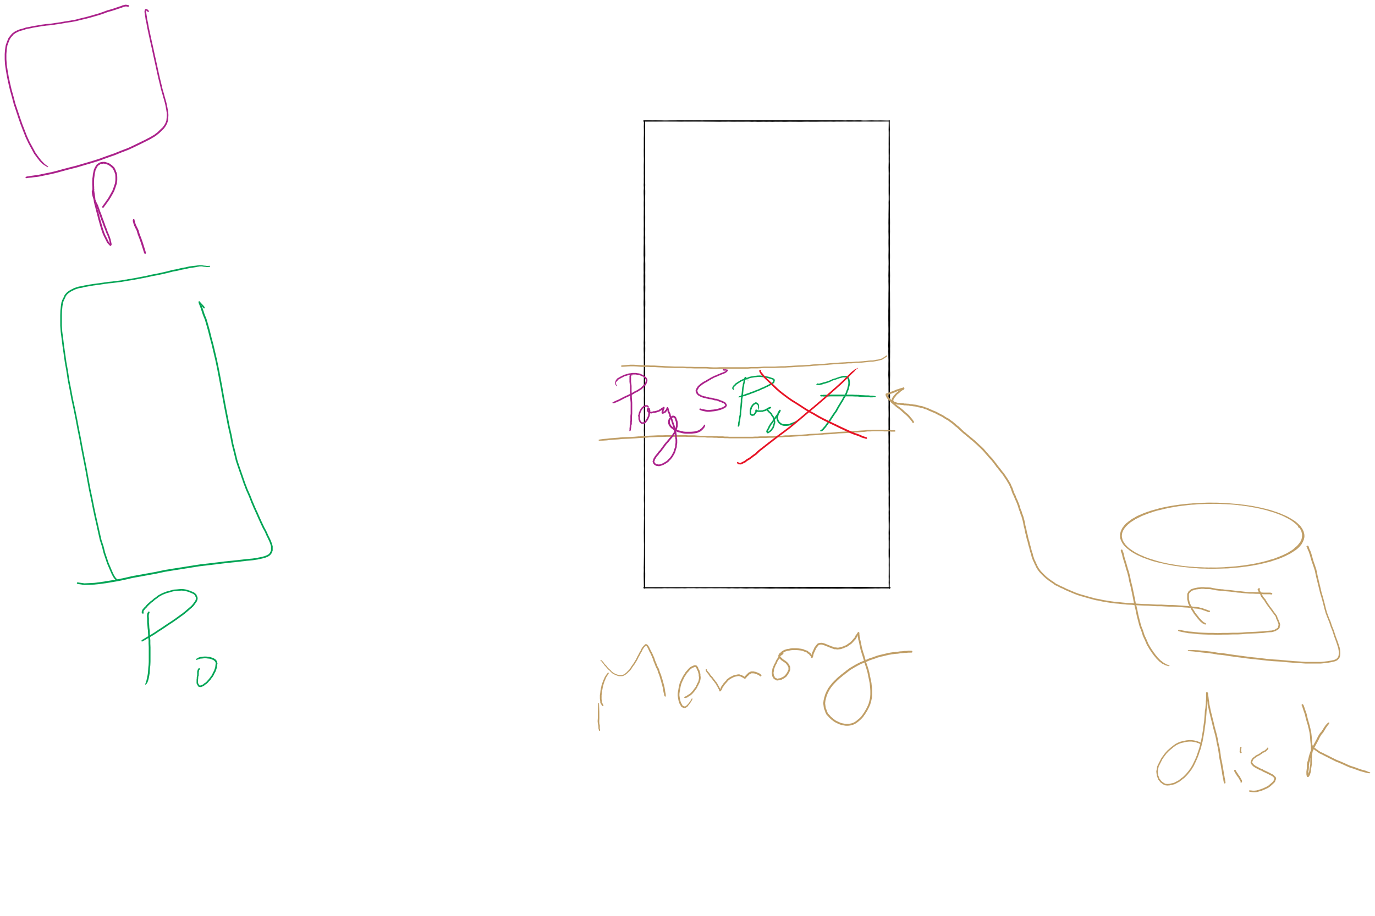
Locking pages in memory
P0 issues call for read from device into P0’s I/O buffer (Page 7 of P0)
While P0 I/O waiting, P1 runs
P1 has a page fault (Page 5)
P0’s I/O buffer chosen to be paged out
I/O device writes to P1’s Page 5 instead of P0’s Page 7!
Solution: allow pages to be locked into physical memory
immune from being replaced
stay locked for (relatively) short periods

Slide 14
When are dirty pages written to disk?
On demand (when they’re replaced)
Fewest writes to disk
Slower page replacement: takes twice as long (must wait for disk write and disk read)
Periodically (in the background)
Background process (called Cleaner) scans through page tables, writes out dirty pages that are pretty old
Cleaner also keeps a list of pages ready for replacement
Page faults handled faster: no need to find space at page fault time
Cleaner may use algorithms discussed earlier (Aging, clock, etc.)

Slide 15
Control overall page fault rate
Despite good designs, system may still thrash
Solution: Reallocate memory frames
What if most (or all) processes have high page fault rate
Some processes need more memory, …
but no processes could give up some memory
No way to reduce page fault rate by reallocation
Solution: Reduce number of processes in memory
Swap one or more processed to disk
Divide up pages they held
Reconsider degree of multiprogramming

Slide 16

Backing up an instruction
Problem: Not always possible to resume an instruction
if page fault in the middle of instruction execution
Part of the instruction may have executed
Some changes may have already happened
Solution:
undo all of the changes made by the instruction
Restart instruction from the beginning
This is easier on some architectures than others
Example: LW R1, 12(R2)
Page fault in fetching instruction: nothing to undo
Page fault in getting value at 12(R2): restart instruction

Slide 17
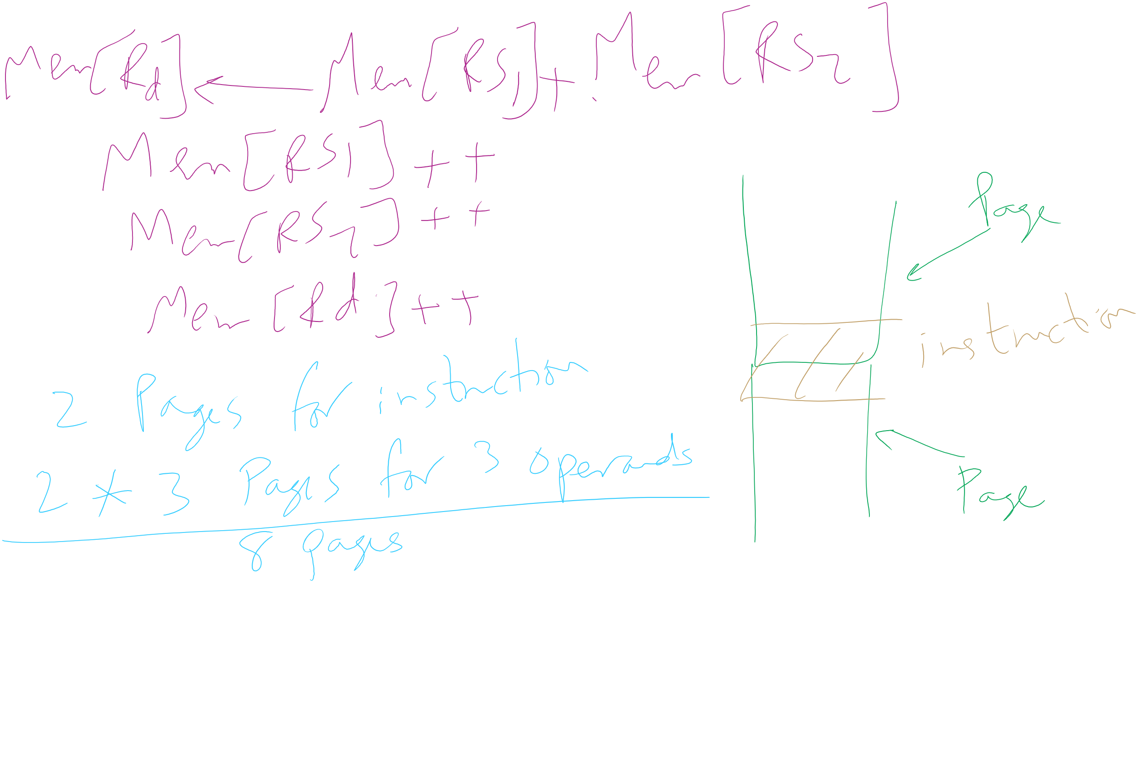
Minimum memory allocation per process
Enough for every single instruction to eventually finish without page faults
Example: ADD (Rd)+,(Rs1)+,(Rs2)+
Page fault in writing to (Rd): may have to undo an awful lot…

Slide 18
Separating policy and mechanism
Mechanism for page replacement has to be in kernel
Reading and writing page table entries
Policy for deciding which pages to replace or where to store evicted pages could be in user space
More flexibility but higher overhed
3. Request page
User process
External pager
4. Page arrives
User space
2. Page needed
5. Here is page!
Kernel space
Fault handler
MMU handler
1. Page fault
6. Map in page

Slide 19
Enter File System!
How to allocate disk blocks to files and directories?

Slide 20
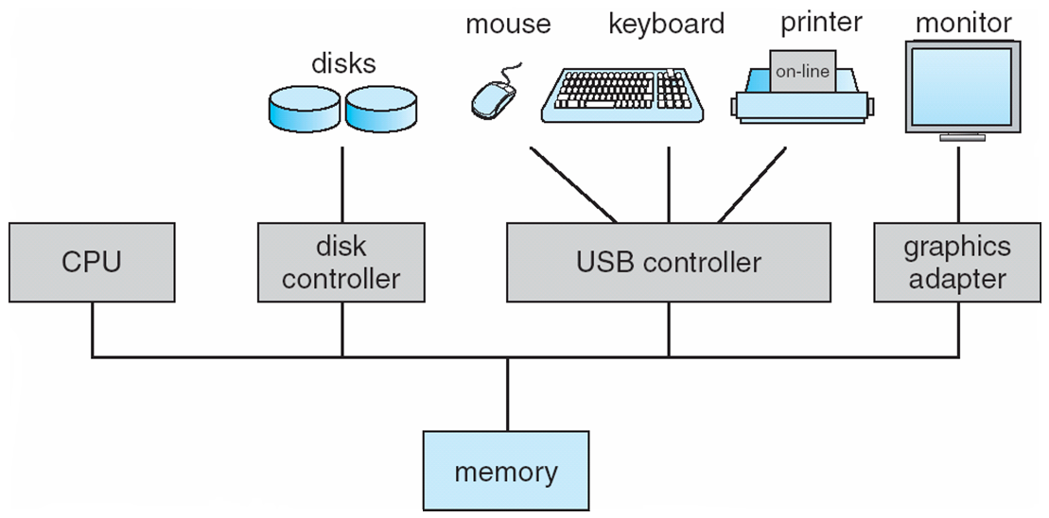
How complex is the OS’s job?
Let’s look at one of the resources managed by the OS: I/O devices

Slide 21
Carving up the disk
Entire disk
Partition table
Master boot record
Partition 1
Partition 2
Partition 3
Partition 4
Boot block
Super block
Free space management
Index nodes
Files & directories

Slide 22
Contiguous allocation
Data in each file in consecutive blocks on disk
Simple & efficient indexing
Index node contains
Starting location (block #) on disk (Start)
Length of file in bytes (Length)
Random access well-supported
0
1
2
3
4
5
6
7
8
9
10
11
Start=5
Length=2902

Slide 23
Contiguous allocation: Logical to Phyiscal Mapping
pos: logical byte number (from the application)
physical_block_num =
(pos / block_size) + start
offset_in_block =
pos % block_size
Example: pos = 2000
physical_block_num = (2000 / 1024) + 5 = 6 offset_in_block = 2000 % 1024 = 976
0
1
2
3
4
5
6
7
8
9
10
11
Start=5
Length=2902

Slide 24
Contiguous allocation: Cons
Problem: Difficult to grow files
Must pre-allocate all needed space
Wasteful of storage if file doesn’t use all allocated space
Problem: deleting files leaves “holes”
Similar to memory allocation issues (CS 0449 heap project)
Compacting the disk is very slow …
A
B
C
D
E
F
A
Free
C
Free
E
F

Slide 25
Linked allocation
File blocks form a linked list
Blocks may be scattered around in disk
Block has pointer to next block
Files grow as large as needed
Indexing is simple
Index node contains
First and last block
Length of file in bytes
Blocks allocated as needed
Linked into list of blocks
Removed from list of free blocks (or bitmap)
No wasted blocks - all blocks can be used
0
1
2
3
4
6
4
5
6
7
x
x
8
9
10
11
0
Start=9
End=4
Length=2902
Start=3
End=6
Length=1500

Slide 26
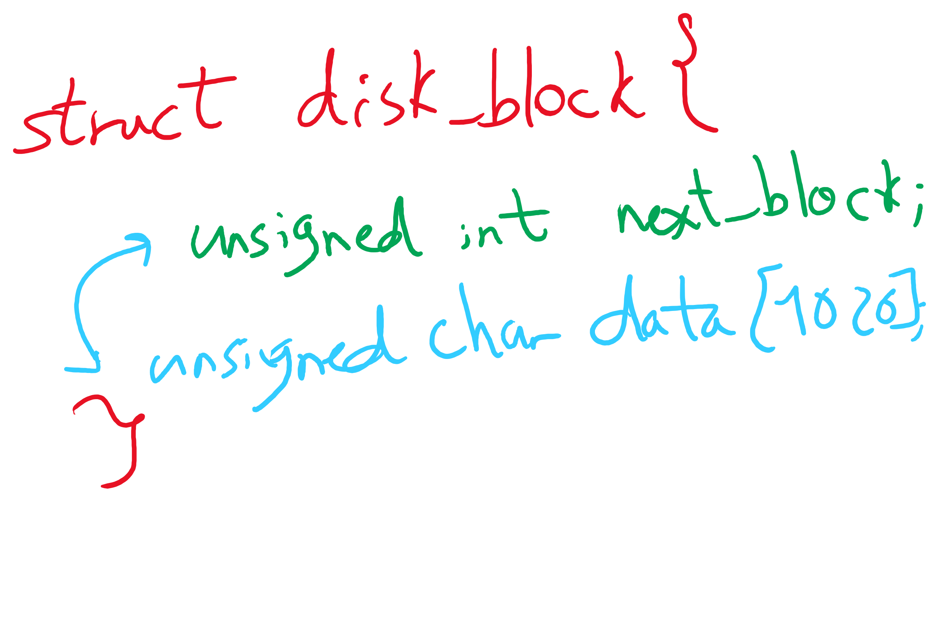
Data Structure for Linked Allocation

Slide 27
Logical to Physical Mapping
block = start logical_block_num = pos / block_size offset_in_block = pos % block_size for (j = 0; j < logical_block_num; j++) {
read disk block no. block block = block->next_block }
Assumes next block pointer stored at end of block. Why?

Slide 28
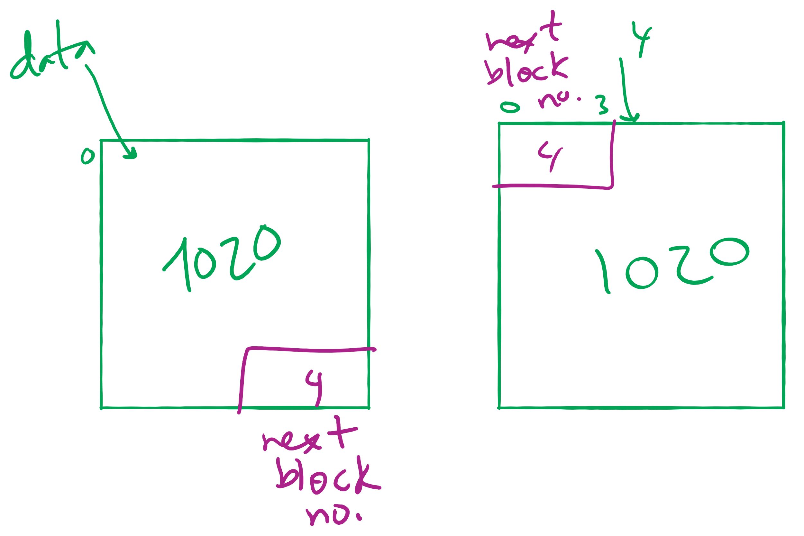
Offset Calculation

Slide 29
Linked allocation: Cons
Random access not possible
May require a long time for seek to random location in file
Overhead of next block pointers in each block

Slide 30
File Allocation Table (FAT)
Keep linked lists in memory
Advantage: faster
Disadvantages
Have to copy it to disk at some point
Have to keep in-memory and on-disk copy consistent
0
4
1
-1
2
-1
3
-2
4
-2
5
-1
6
3
B
7
-1
8
-1
9
0
A
0
1
2
3
10
-1
4
6
11
-1
4
5
6
7
12
-1
x
x
13
-1
8
9
10
11
14
-1
0
15
-1
File A
File B

Slide 31
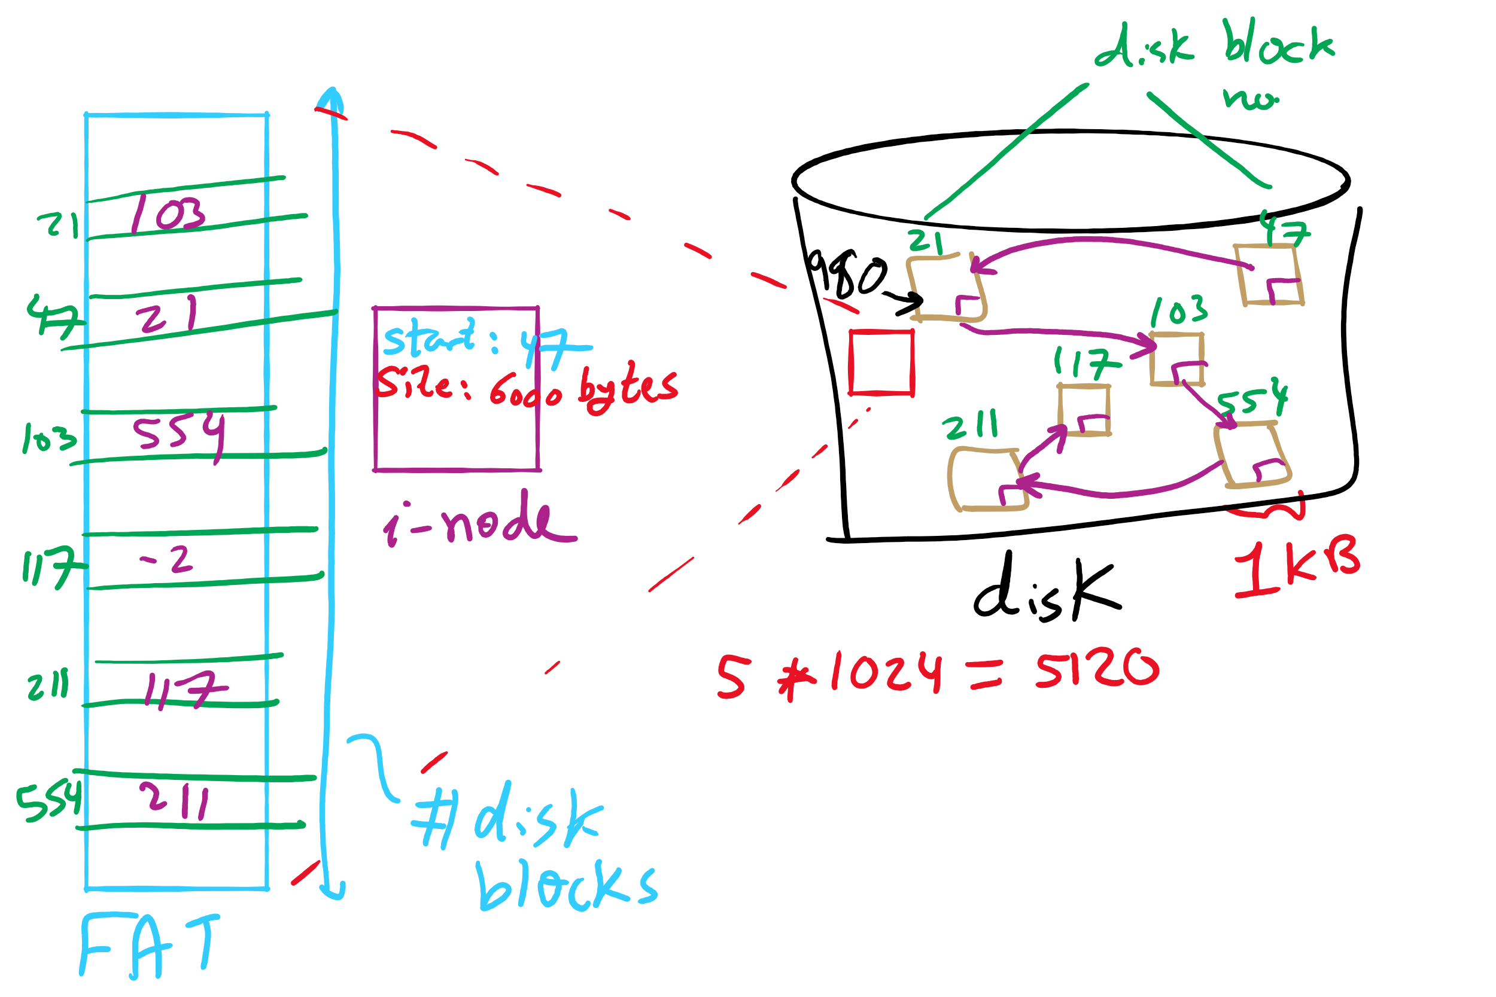
FAT Example

Slide 32
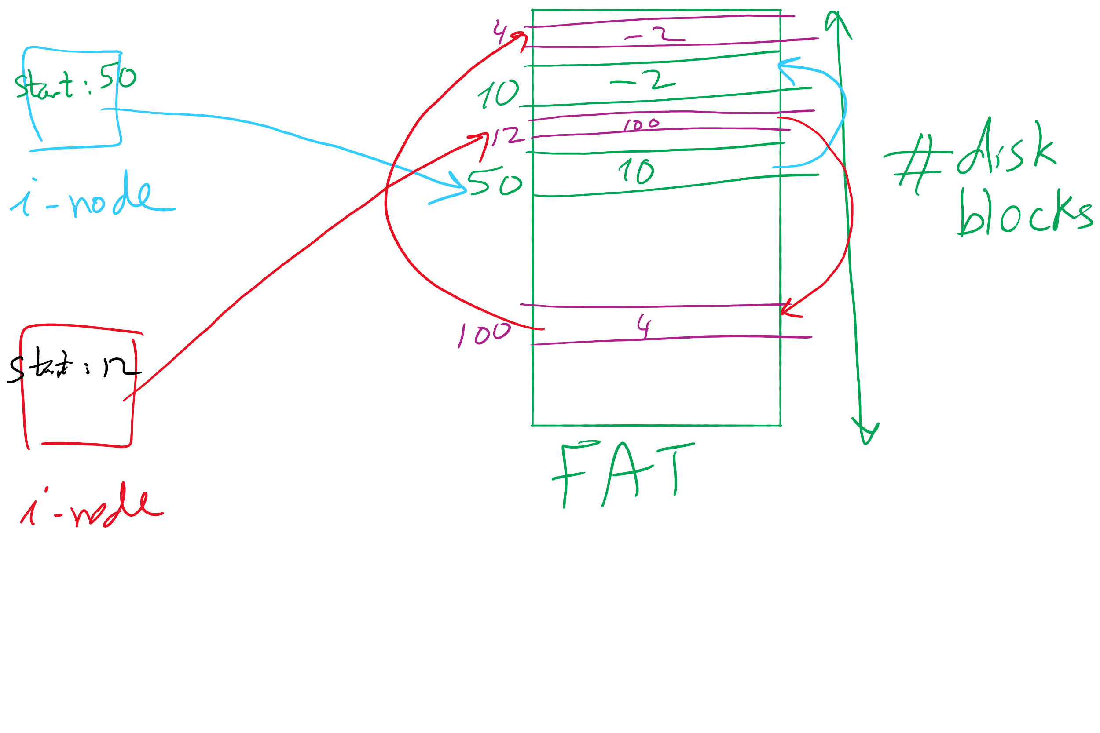
index nodes and FAT

Slide 33
Indexed Allocation
Store file block addresses in an array (called index)
Array itself is stored in a disk block
Index node has a pointer to index disk block
Non-existent blocks indicated by -1
Random access easy
Cons: Limit on file size!
Index Length
4 4802
0
1
2
3
6
9
7
0
8
4
5
6
7
8
9
10
11

Slide 34
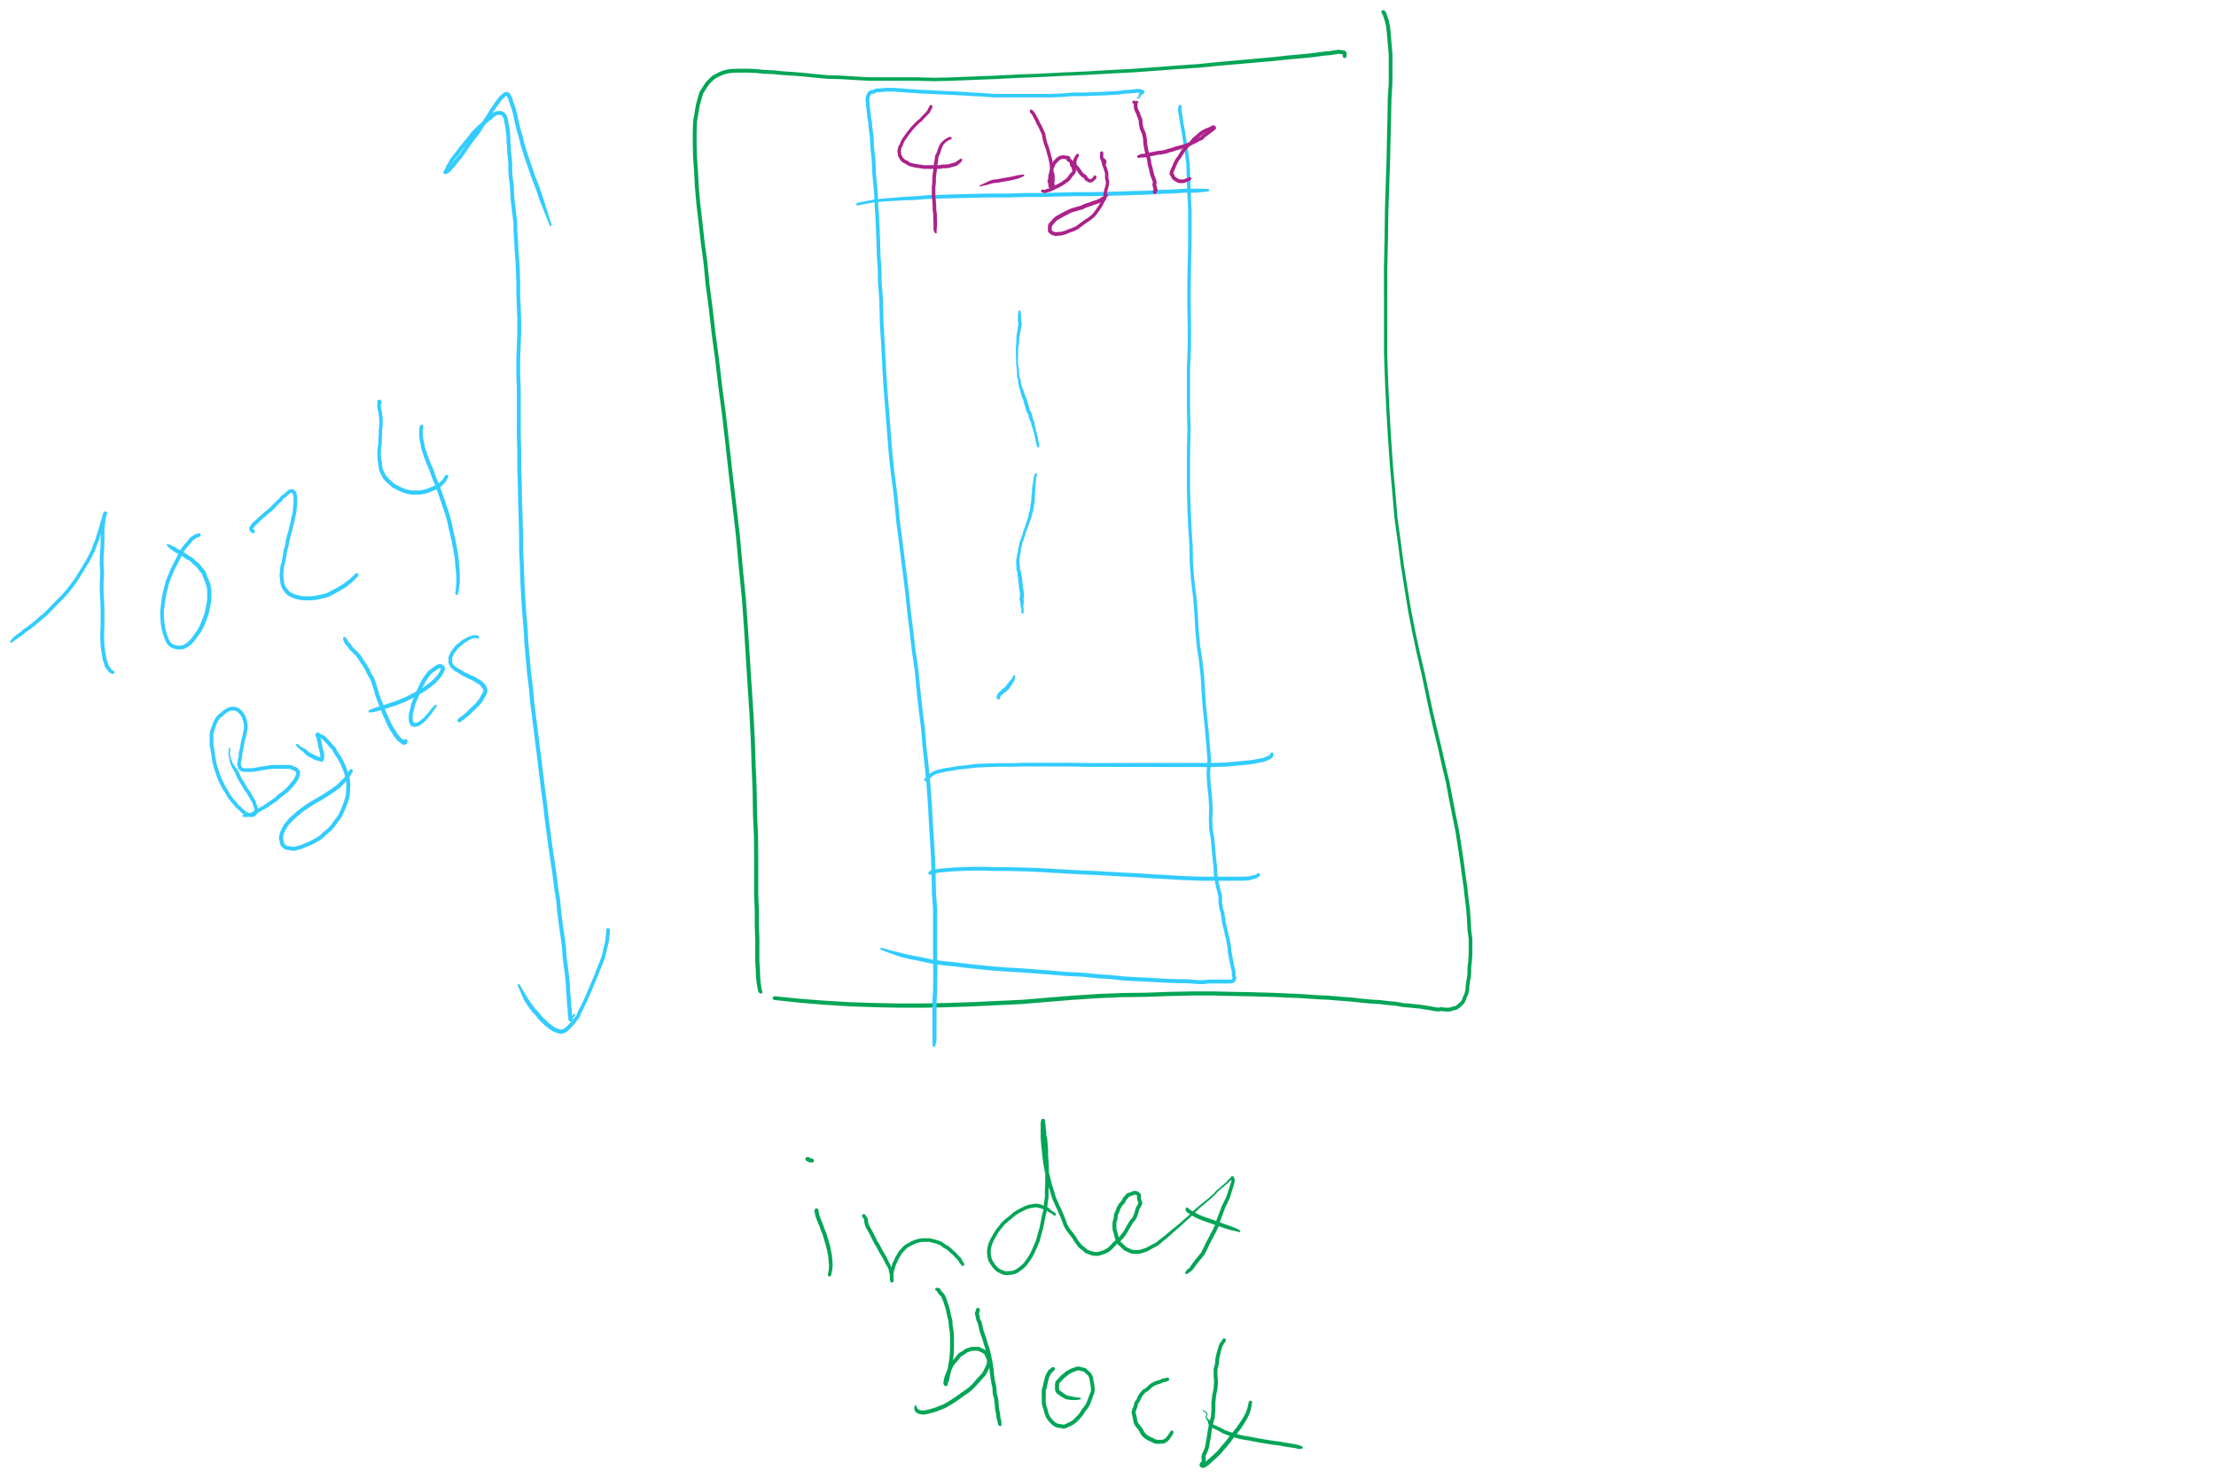
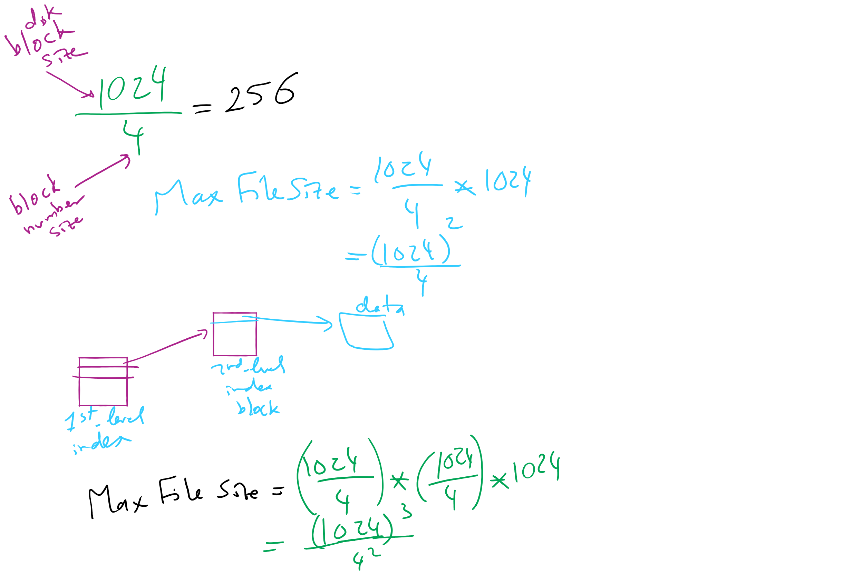
Max File Size for Indexed Allocation

Slide 35
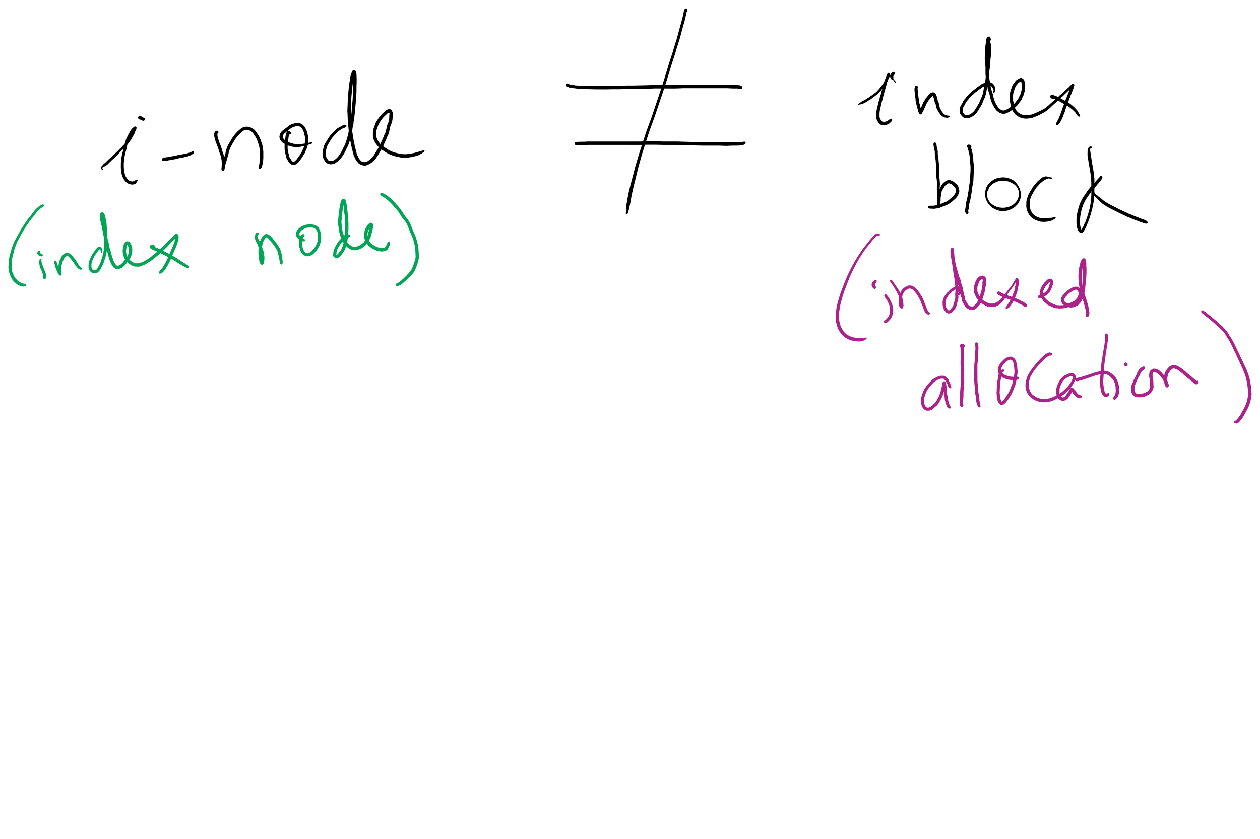
i-node vs index block

Slide 36
Hybrid Allocation (Lab 5)
Unix Fast File System indexing scheme
protection mode
data
owner & group
data
.
.
.
timestamps
size
data
block count
•
data
•
.
.
.
link count
•
Direct pointers
.
.
.
•
data
•
•
data
•
.
.
.
•
•
single indirect
•
•
data
double indirect
•
•
data
•
•
•
•
.
.
.
triple indirect
•
•
•
inode
•
•
•
data

Slide 37
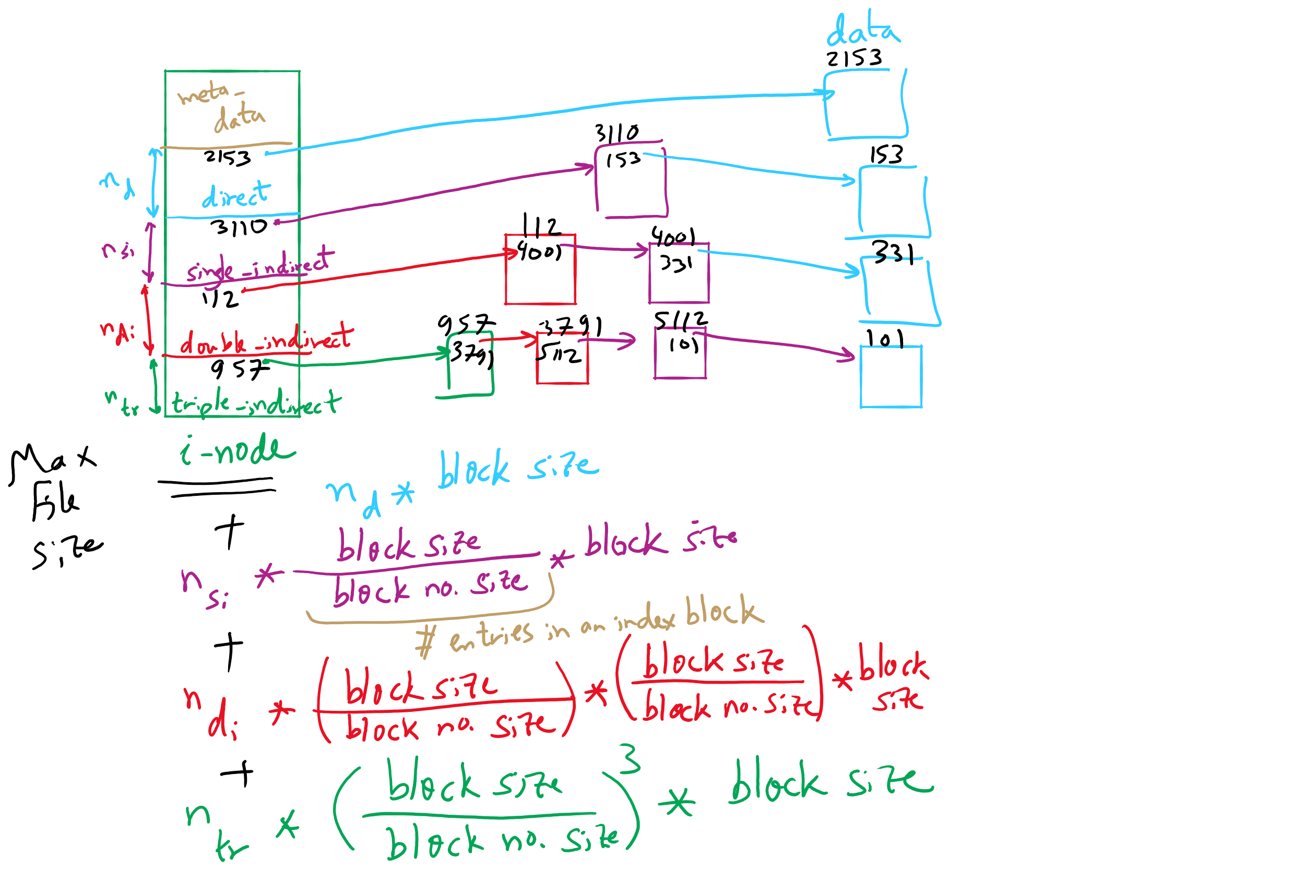
FFS Example

Slide 38
FFS and Max File Size

Slide 39
What’s in a file directory?
Two types of information needed about a file
File names
File metadata (size, timestamps, etc.)
Basic choices for directory information
Store all information in directory
Fixed size entries
Disk addresses and attributes in directory entry
Store names & pointers to index nodes (i-nodes)
attributes
games
attributes
games
mail
attributes
mail
attributes
news
attributes
news
attributes
research
attributes
research
Storing all information in the directory
Using pointers to index nodes
attributes

Slide 40
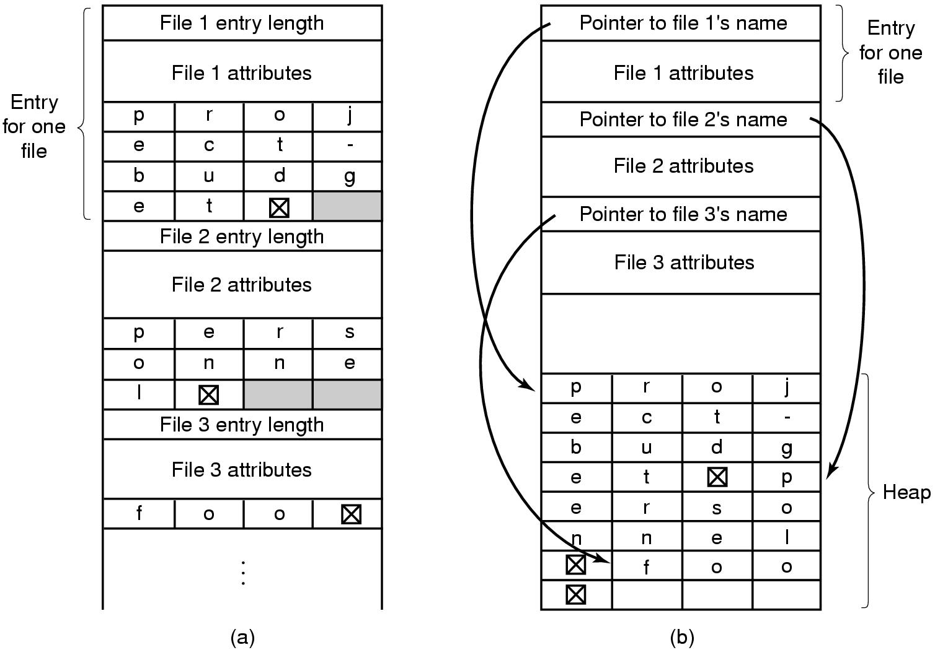
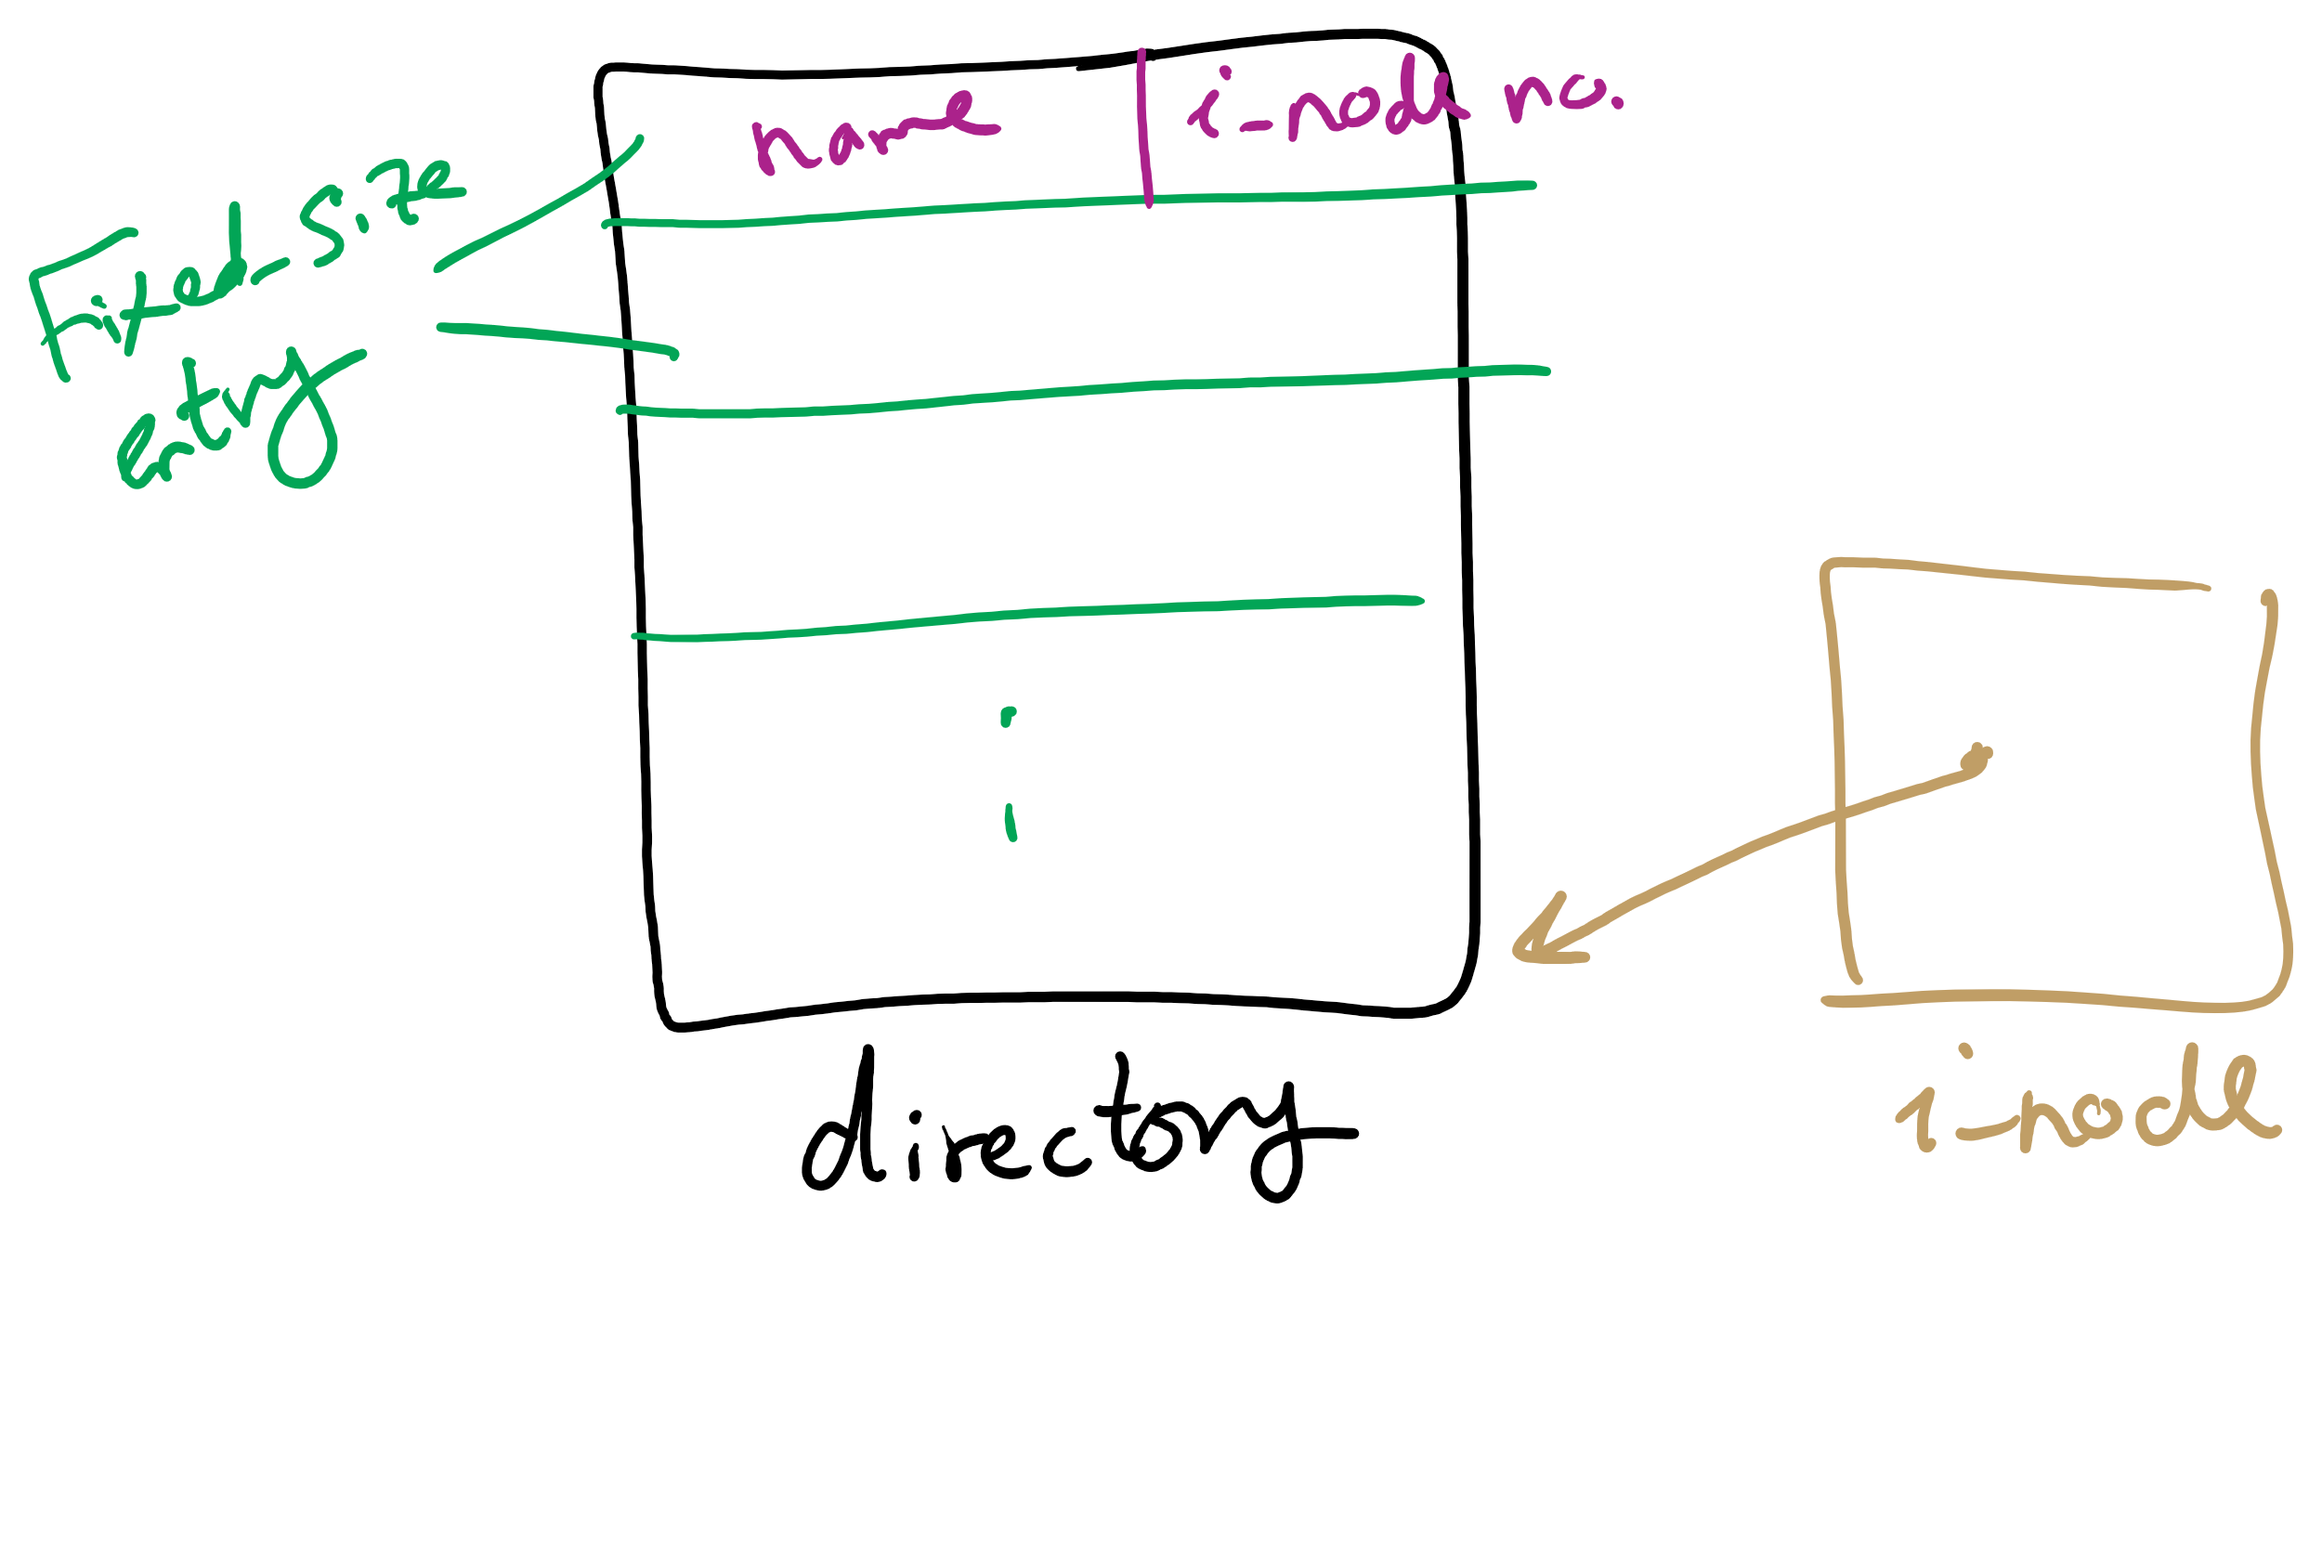
Handling long file names in a directory

Slide 41
Free Block Tracking
10

Slide 42
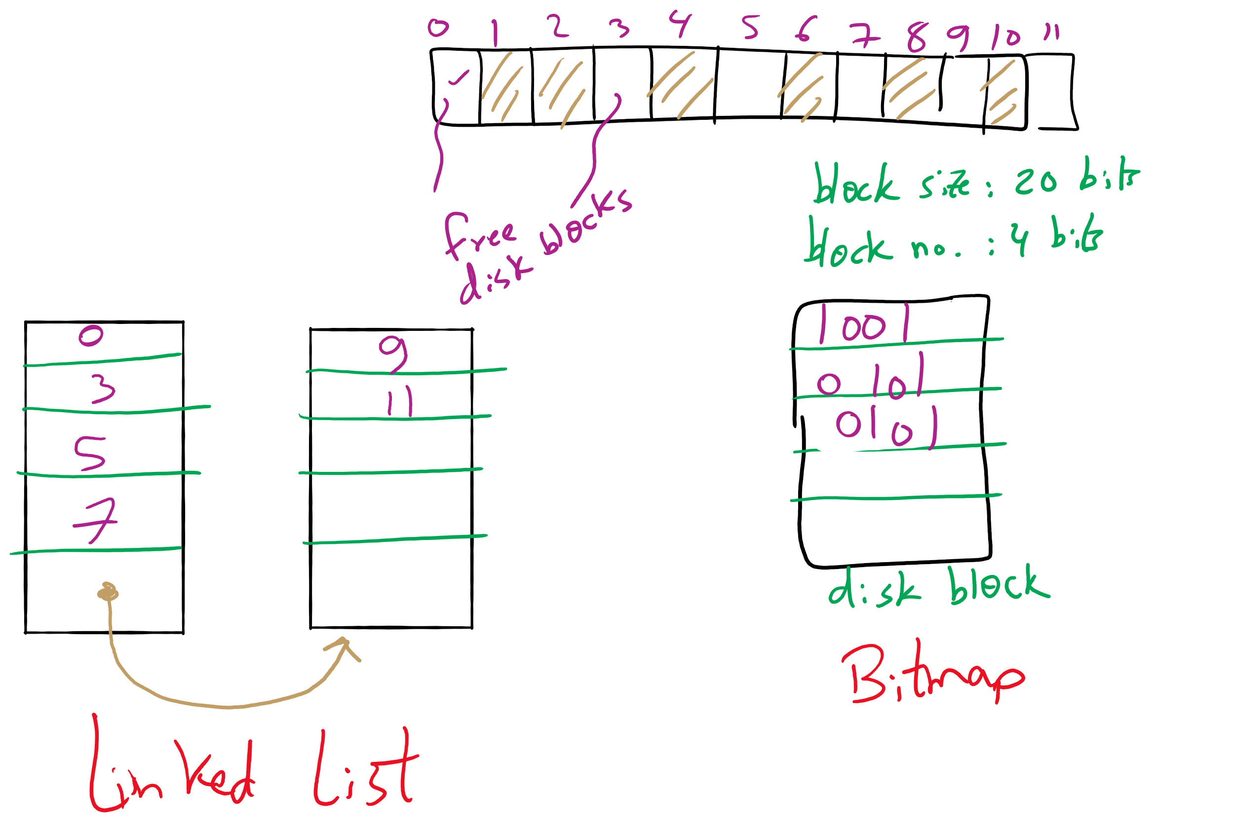
Free Block Tracking Example 1

Slide 43
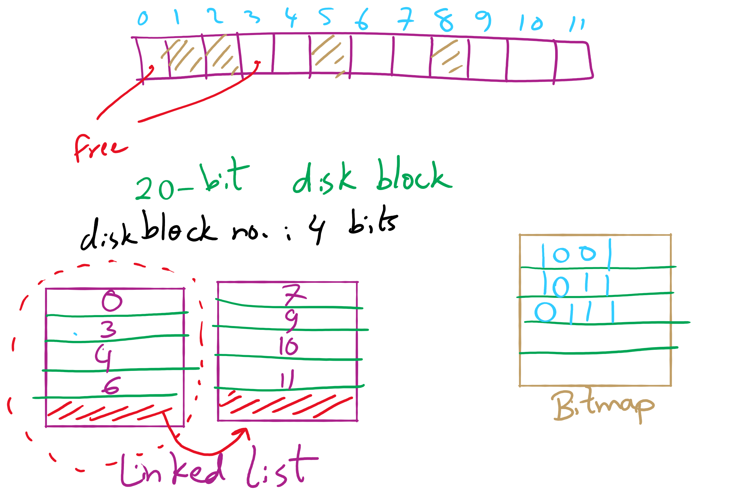
Free Block Tracking Example 2

